Slide 1
预训练语言模型应用调优算法
DataIsPower
韩程程、朱仁煜、陈诺、孙秋实、龚敬洋
指导老师：高明、李翔
华东师范大学
数据科学与工程学院
Notes:
Hello, everyone. I’m the first author and a Ph.D. student from the School of Data Science and Engineering at East China Normal University. I’m glad to introduce our ACL paper, “A Neural Network Architecture for Program Understanding Inspired by Human Behaviors.”

Slide 2
Table of Contents
Background
Related work
Exploration
Method
In²-Initialization
Two-stage DFO
M²-Verbalizers
Experiments
Conclusion
Notes:
This presentation is structured as follows, including background, method, experiment, and conclusion.

Slide 3
Background
Language-Model-as-a-Service (LMaaS)
Big Data
(MLM/LM Pre-Training)
Small Data
(Task-Specific Prompt)
Inference API
Black Box
Up-Stream
Down-Stream
Notes:
Now, we are in a “big code” era. The past decades have witnessed the prosperity of programming platforms, such as Github and Stack Overflow. These platforms generate massive open-source code data that is named as “Big Code”.

Slide 4
Related Work
Text prompt ^{[1] [2]}
In-context learning ^{[3] [4]}
Instruction learning
GRIPS^{[5]}
NATURAL INSTRUCTIONS^{[6]}
RL-based Methods
RLprompt ^{[7]}
DFO-based Methods
BBT ^{[8]}
BBTv2 ^{[9]}
Notes:
This presentation is structured as follows, including background, method, experiment, and conclusion.

Slide 5
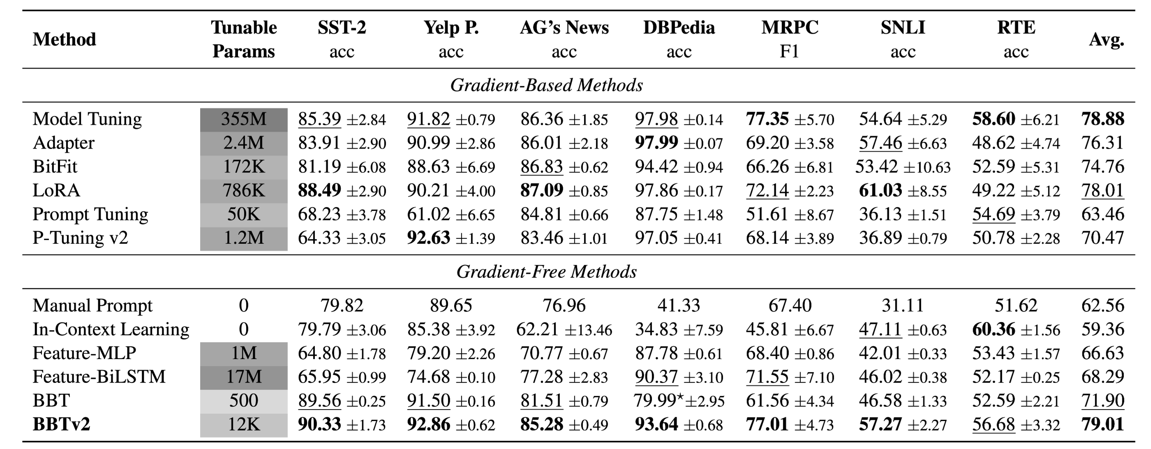
DFO-based Methods
BBT ^{[8]}
BBTv2 ^{[9]}
Notes:
And why do we do program understanding? It is a fundamental task in programming language processing, which aims at learning an embedding from raw code by using neural networks. In this “big code” era, program understanding can support us in automatic software development and maintenance, such as code summarization and code clone detection.

Slide 6
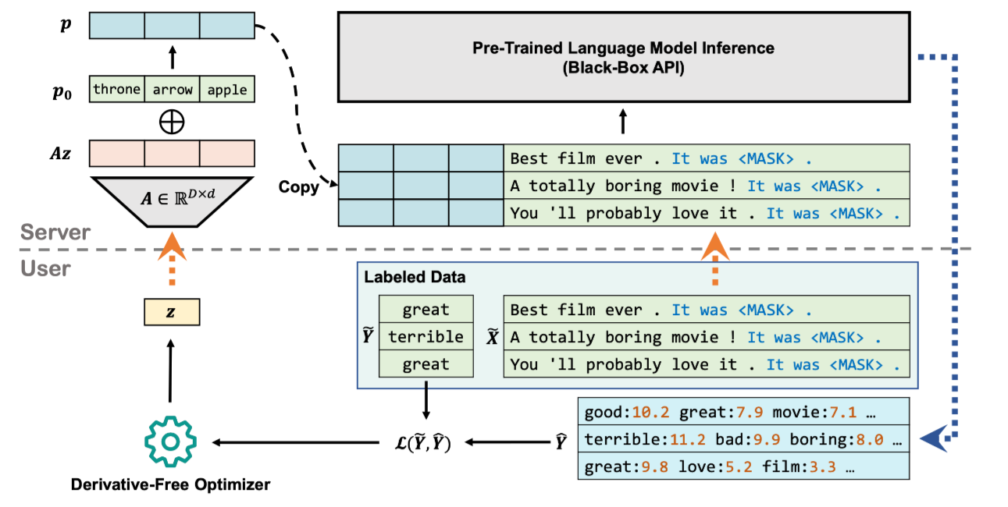
Exploration
1. DFO
Powell ^{[9]}, COBYLA ^{[10]}, …
ESRL ^{[11]}, ERL ^{[12]}, CERL ^{[13]}
2. Random Matrix
Normal, Truncated Normal
Xavier ^{[16]}, Kaiming Init ^{[17]}
3. Initial Prompt
In-context^{[3]}, Instruction^{[5]}, RLprompt^{[7]}
4. Combination Preorder, Inorder, Postorder
5. Verbalizers AutoL^{[18]}, Synonym, Frequency, TF-IDF
6. Loss Function CE, Hinge, -F1
3
2
4
1
6
5
Notes:
Each code has two modalities, namely raw code and complied AST or other graphs.

Slide 7
Method
BBT-RGB
M²-Verbalizers
Loss
Prediction
0 : bad, terrible, painful.
1 : great, good, extraordinary.
Language model head
$$z^{l}$$
Hidden states ($p_{0}$)
Hidden states (sentence + template)
…
…
…
$$z^{2}$$
Hidden states ($p_{0}$)
Hidden states (sentence + template)
$$z^{1}$$
Embedding ($p_{0}$)
Embedding (sentence + template)
Two-stage DFO
$$p_{0}$$
Sentence + template
In²-Initialization
Manual instruction
Auto-selected demonstration
Model name is inspired by Rainbow^{[15]}.
Notes:
Each code has two modalities, namely raw code and complied AST or other graphs.

Slide 8
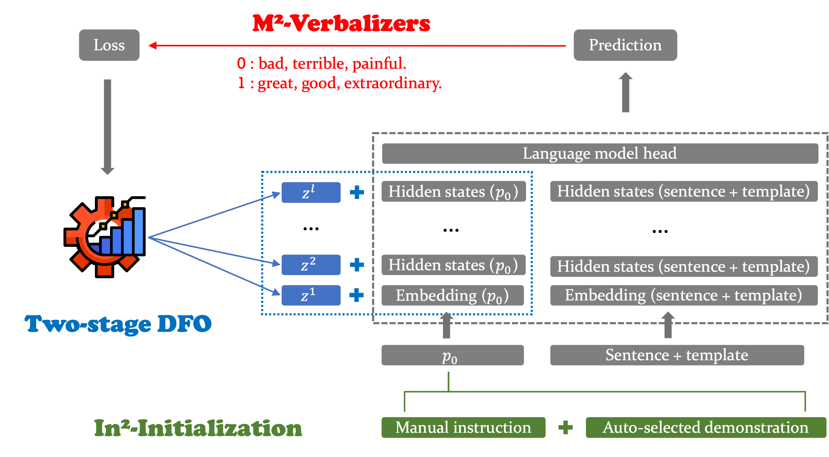
In²-Initialization
Instruction Learning^{[5]}
+
In-context Learning^{[3]}
(Auto-selected from training data)
E.g. SST-2
Your task is to classify the movie review as bad or great based on its content . For example , a moving essay about the specter of death , especially suicide . It was great.
Notes:
Each code has two modalities, namely raw code and complied AST or other graphs.

Slide 9
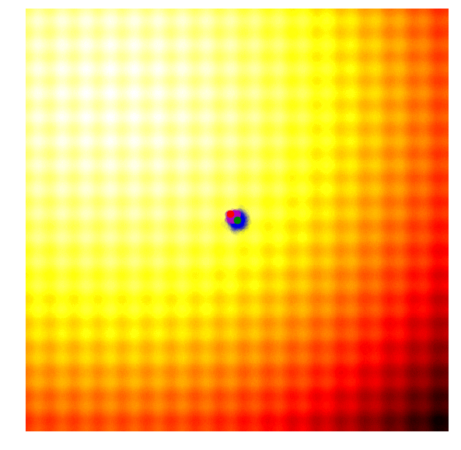
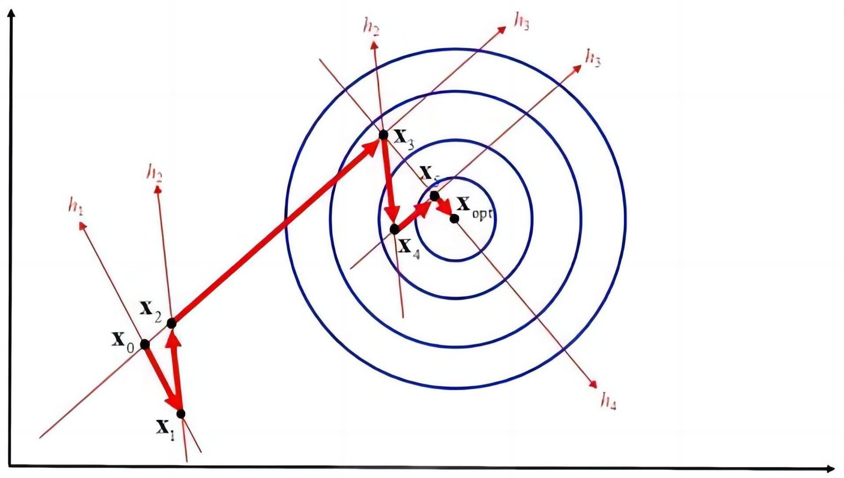
Two-stage DFO
Two-stage Optimization:
The first stage: CMA-ES ^{[14]}
The second stage:
Powell^{[9]} or COBYLA ^{[10]}
CMA-ES
Powell
Notes:
Existing works mainly explore the fusion way of the two modalities or try to introduce external knowledge, for example, many pre-training models. But, these methods fail to take human behaviors as a reference. Maybe you are wondering why I will consider human behaviors. Actually, as a cs Ph.D. student, I have been coding for many years and have some personal understanding of how to code. In my opinion, some existing works can be regarded as a subset of human behaviors.

Slide 10
M²-Verbalizers
Multi-Mixed-Verbalizers
Verbalizer Construction Methods:
Manual Verbalizers
Synonym
Search-based Verbalizers
TF-IDF
Auto-generated Verbalizers
AutoL ^{[18]}
E.g. SST-2
0: bad 0: [bad, terrible, drag, painful, awful, ugly, …]
1: great 1: [great, good, pretty, delightful, adorable, …]
Notes:
Existing works mainly explore the fusion way of the two modalities or try to introduce external knowledge, for example, many pre-training models. But, these methods fail to take human behaviors as a reference. Maybe you are wondering why I will consider human behaviors. Actually, as a cs Ph.D. student, I have been coding for many years and have some personal understanding of how to code. In my opinion, some existing works can be regarded as a subset of human behaviors.

Slide 11
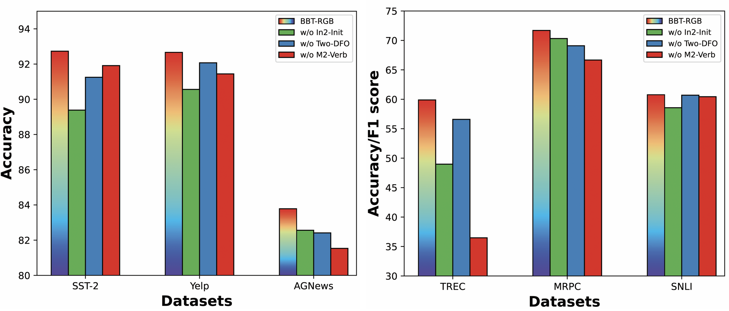
Experiments
Notes:
Existing works mainly explore the fusion way of the two modalities or try to introduce external knowledge, for example, many pre-training models. But, these methods fail to take human behaviors as a reference. Maybe you are wondering why I will consider human behaviors. Actually, as a cs Ph.D. student, I have been coding for many years and have some personal understanding of how to code. In my opinion, some existing works can be regarded as a subset of human behaviors.

Slide 12
Conclusion
BBT-RGB
M²-Verbalizers
Loss
Prediction
0 : bad, terrible, painful.
1 : great, good, extraordinary.
Language model head
$$z^{l}$$
Hidden states ($p_{0}$)
Hidden states (sentence + template)
…
…
…
$$z^{2}$$
Hidden states ($p_{0}$)
Hidden states (sentence + template)
$$z^{1}$$
Embedding ($p_{0}$)
Embedding (sentence + template)
Two-stage DFO
$$p_{0}$$
Sentence + template
In²-Initialization
Manual instruction
Auto-selected demonstration
Notes:
Each code has two modalities, namely raw code and complied AST or other graphs.

Slide 13
Future Work
Multi-stage DFO : Convergence of multiple different DFO algorithms to achieve better optimization performance.
Design a new random mapping matrix or a new dimension transformation method.
Combine DFO and gradient descent optimization.
Notes:
Each code has two modalities, namely raw code and complied AST or other graphs.

Slide 14
Reference
[1] Brown T, Mann B, Ryder N, et al. Language models are few-shot learners[J]. Advances in neural information processing systems, 2020, 33: 1877-1901.
[2] Gao T, Fisch A, Chen D. Making pre-trained language models better few-shot learners[J]. arXiv preprint arXiv:2012.15723, 2020.
[3] Min S, Lyu X, Holtzman A, et al. Rethinking the Role of Demonstrations: What Makes In-Context Learning Work?[J]. arXiv preprint arXiv:2202.12837, 2022.
[4] Zhao Z, Wallace E, Feng S, et al. Calibrate before use: Improving few-shot performance of language models[C]//ICML, 2021: 12697-12706.
[5] Prasad A, Hase P, Zhou X, et al. Grips: Gradient-free, edit-based instruction search for prompting large language models[J]. arXiv:2203.07281, 2022.
[6] Mishra S, Khashabi D, Baral C, et al. Cross-task generalization via natural language crowdsourcing instructions[J]. arXiv preprint arXiv:2104.08773, 2021.
[7] Deng M, Wang J, Hsieh C P, et al. RLPrompt: Optimizing Discrete Text Prompts With Reinforcement Learning[J]. arXiv:2205.12548, 2022.
[8] Sun T, Shao Y, Qian H, et al. Black-box tuning for language-model-as-a-service[J]. arXiv preprint arXiv:2201.03514, 2022.
[9] Sun T, He Z et al. BBTv2: Pure Black-Box Optimization Can Be Comparable to Gradient Descent for Few-Shot Learning[J]. arXiv:2205.11200, 2022.
Notes:
Each code has two modalities, namely raw code and complied AST or other graphs.

Slide 15
Reference
[9] Powell M J D. An efficient method for finding the minimum of a function of several variables without calculating derivatives[J]. CL, 1964, 7(2): 155-162.
[10] Powell M J D. Direct search algorithms for optimization calculations[J]. Acta numerica, 1998, 7: 287-336.
[11] Salimans T, Ho J, Chen X, et al. Evolution strategies as a scalable alternative to reinforcement learning[J]. arXiv preprint arXiv:1703.03864, 2017.
[12] Khadka S, Tumer K. Evolution-guided policy gradient in reinforcement learning[J]. Advances in Neural Information Processing Systems, 2018, 31.
[13] Khadka S, Majumdar S, Nassar T, et al. Collaborative evolutionary reinforcement learning[C]//ICML. 2019: 3341-3350.
[14] Hansen N, Ostermeier A. Completely derandomized self-adaptation in evolution strategies[J]. Evolutionary computation, 2001, 9(2): 159-195.
[15] Hessel M, Modayil J, Van Hasselt H, et al. Rainbow: Combining improvements in deep reinforcement learning[C]//AAAI. 2018.
[16] Glorot X, Bengio Y. Understanding the difficulty of training deep feedforward neural networks[C]// AISTATS, 2010: 249-256.
[17] He K, Zhang X, et al. Delving deep into rectifiers: Surpassing human-level performance on imagenet classification[C]//ICCV. 2015: 1026-1034.
[18] Gao T, Fisch A, Chen D. Making pre-trained language models better few-shot learners[J]. arXiv preprint arXiv:2012.15723, 2020.
Notes:
Each code has two modalities, namely raw code and complied AST or other graphs.

Slide 16
Thank you!
Notes:
Thanks for your listening. Welcome to contact us if you have any problems. Thank you!

